Slide 1
Annotation Sensitivity: Training Data Collection Methods Affect Model Performance
Stephanie Eckman
Christoph Kern, Jacob Beck, Bolei Ma, Rob Chew, Frauke Kreuter

Slide 2
“The bias I am most nervous about is the bias of the human feedback raters“
Sam Altman
March 25 2023 “The Lex Fridman Podcast“
Notes:
Sam Altman
Open AI -- 3, Chat, 4
all use labeled training data
he's concerned about bias of human feedback rates
how can we help ML field collect high quality training data to aid model development

Slide 3
Research design
Conditions
x
Hate Speech
Offensive Language

Slide 4
Data Collection
3000 tweets (Davidson et al 2017)
~900 annotators from Prolific (Nov-Dec 2022)
50 tweets / annotator
3 annotations / tweet - condition
15 total annotations / tweet
Notes:
With these data we can look at how conditoins impact labels
But what we really wanted to do in this paper is study impact of conditions on MODELS

Slide 5
Model Training
Train A
Training Set
N=2,250
Train B
Train C
Train D
Train E
Test A
Test B
Test Set
N=750
Test C
Test D
Test E
Notes:
Before we look at model performance let me expain how we conducted the training process:
To train models we split our 3k in test and train.
Each of the tweets was annotated in each of the conditions.
So we took training data from each of the conditions, trained a model and tested on test data from each of the cond

Slide 6
3 types of results
Annotations
Models
Predictions

Slide 7
Annotations
A
B
C
D
E
0% 20% 40% 60%
0% 20% 40% 60%
Notes:
first compare annotations by condition
On y axis you have the 5 exp cond. (little icons)
x axis you can see the % of OL/Hs annotations.
We see some interesting diff.-- ex. Condition D and E
may be related to motivated misreporting

Slide 8
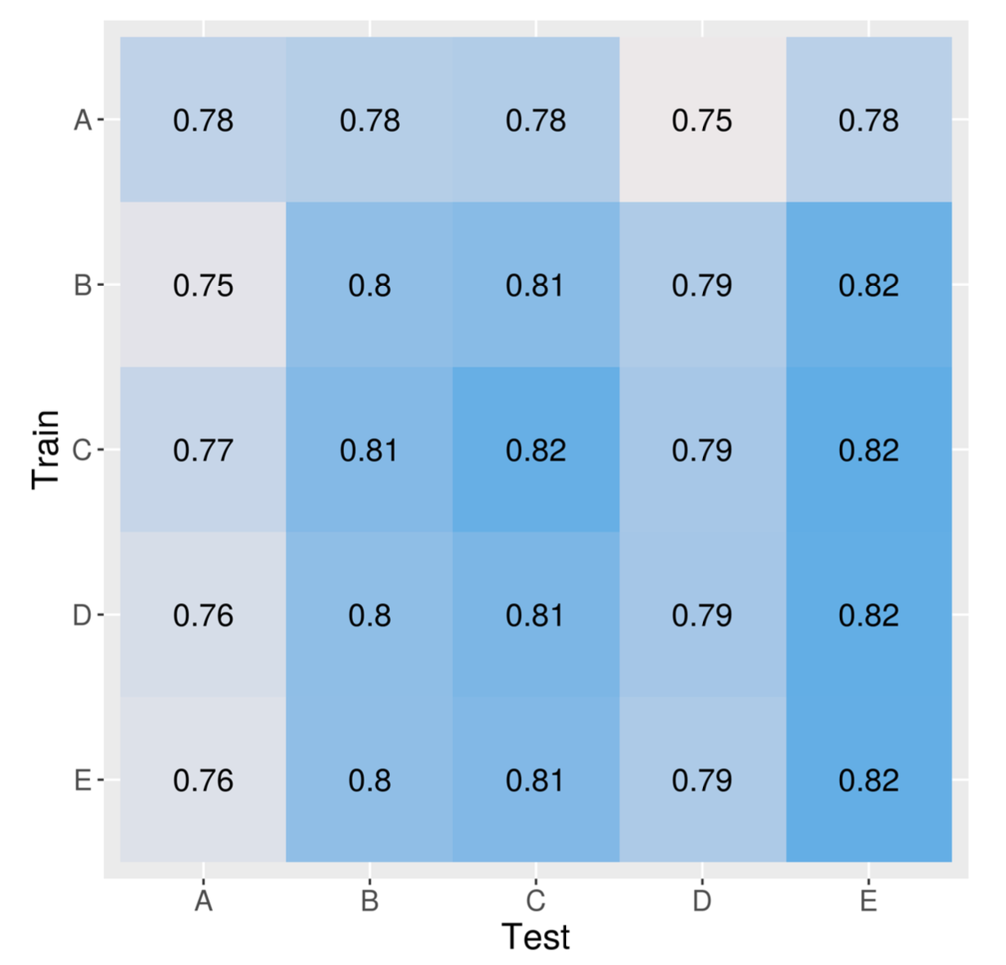
Model Performance
BERT models of offensive language
Number shown is balanced accuracy
A
B
C
D
E

Slide 9
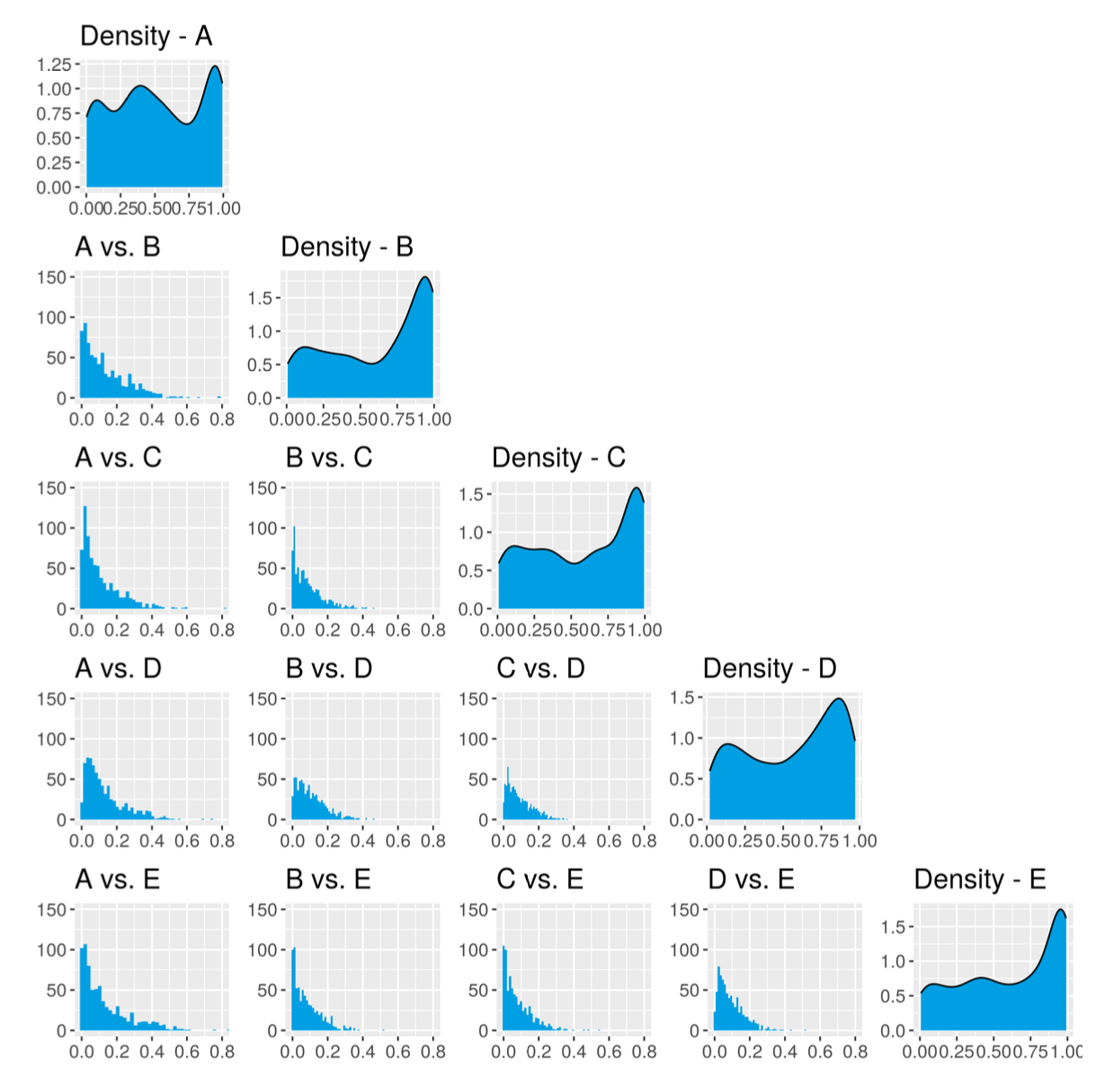
Predictions
Diagonal:
distribution of annotations by conditions
Off-diagonal:
Absolute difference of predictions

Slide 10
Takeaways
How you collect annotations matters
for labels, models, predictions
Some conditions perform better/worse as train/test data
More research needed to inform best practices
Some evidence of fatigue
Fewer offensive speech labels in Condition D
Fewer hate speech labels in Condition E
Notes:
Survey methods can help ML!

Slide 11
THANK YOU
Stephanie Eckman
Social Data Science Center, University of Maryland
steph@umd.edu
stepheckman.com

Slide 12
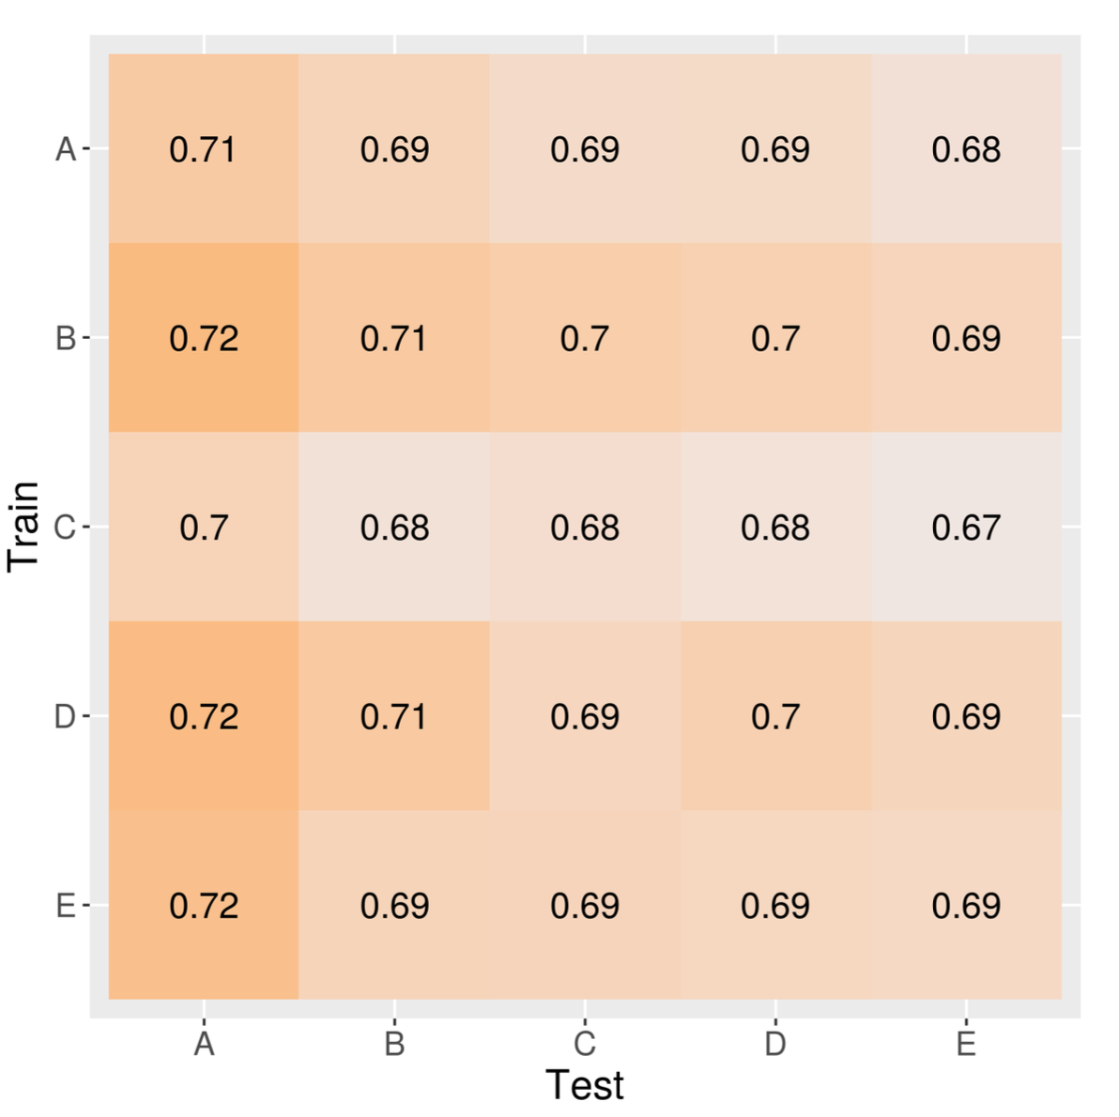
Notes:
Balanced accuracy, BERT, HS

Slide 13
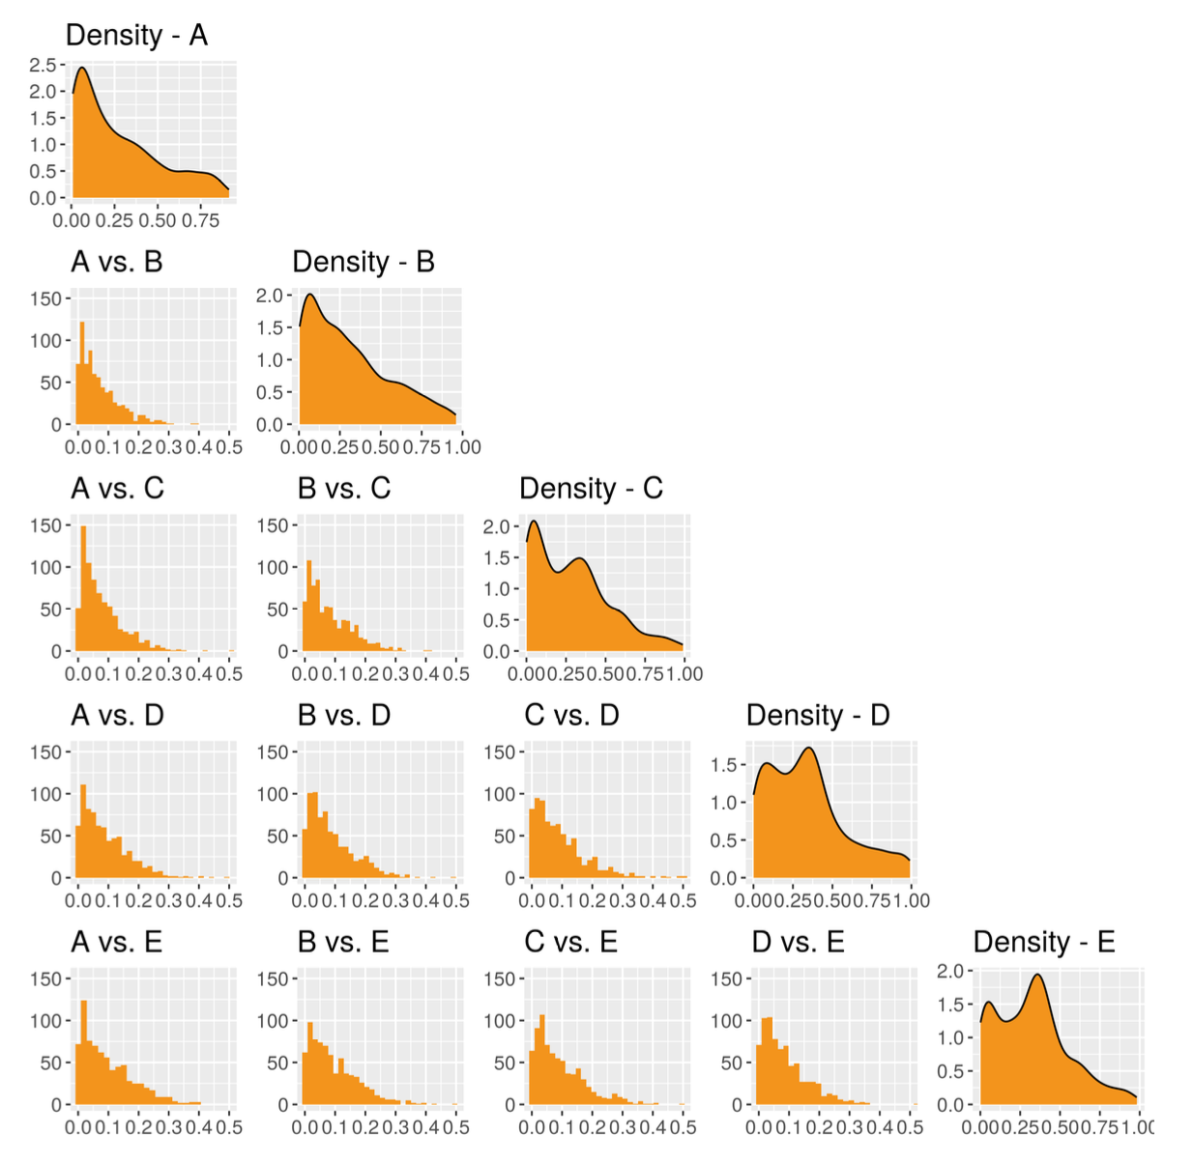
Notes:
Predictions, BERT, HS

Slide 14
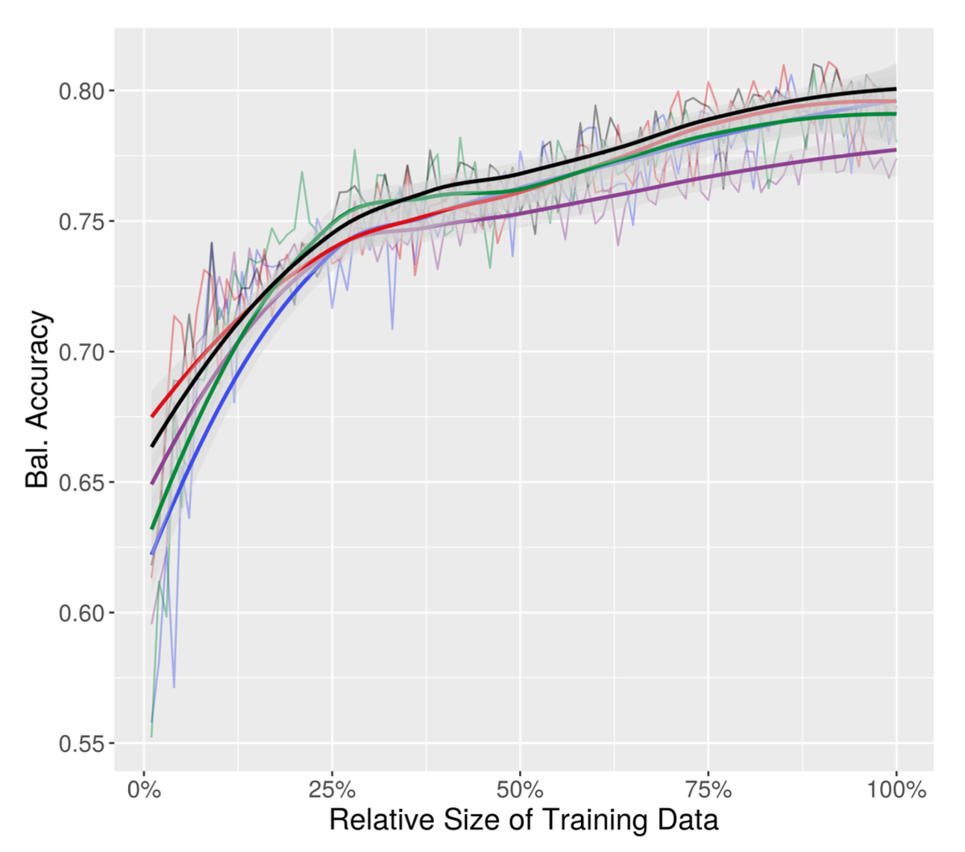
Notes:
learning curves: BERT, OL

Slide 15
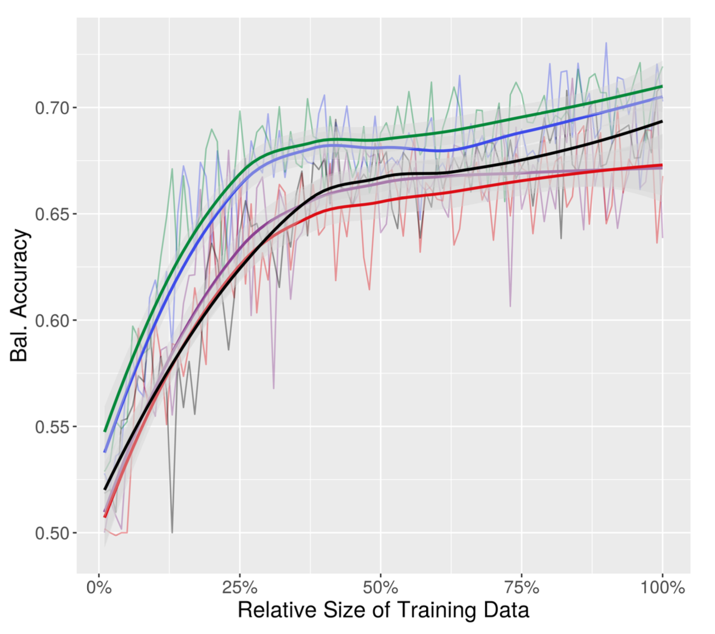
Notes:
learning curves: BERT, OL

Slide 16
Next steps
Replicate with other training data
Images
Less subjective tasks
Compare labels from existing annotation platforms
Preannotation
Vary annotators
Experts & gig workers
Representative & volunteer

